Slide 1
INFORMATION THEORY
Week 2
Measure of information. Entropy
IITU, ALMATY, 2019
Notes:
IITU, Almaty, Fall 2012
SEPTEMBER 5, 2012
By Assem Zhamankulova, MSCS

Slide 2
Measure of information
Entropy
Hartley's formula
Shannon’s formula
Information capacity of code
Efficiency and redundancy of the code

Slide 3
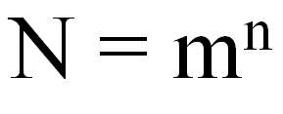
An alphabet of message source consists of m characters, each of which can be a message element. The N number of possible messages of n length equals to the number of permutations with unlimited repetitions:

Slide 4

Measure of information
Logarithm of states number is taken as a measure of the uncertainty of the source state selection with equiprobable states.

Slide 5

Hartley’s formula
Hartley’s formula (1928)
K – number of equiprobable events;
I – the number of bits in the message that any of the K events happened.

Slide 6
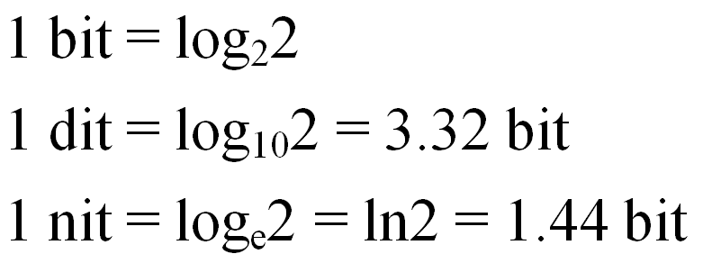
Units of information

Slide 7
Example
Problem
The ball is in the one of three boxes: A, B or C. Determine how many bits of information are contained in the message that it is located in the urn B.
Solution
This message contains I = log2(3) = 1,585 bits of information

Slide 8
From Information to Entropy
Entropy is a measure of uncertainty.
Information is a measure of a reduction in that uncertainty.
The information of the message:
I = H0-H1
H0 – the entropy before the message
H1 – the entropy after the message

Slide 9
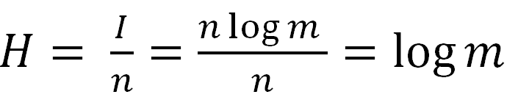

Definition of Entropy
The amount of information that falls on one element of the message (sign, letter) is called entropy:
(bits)

Slide 10
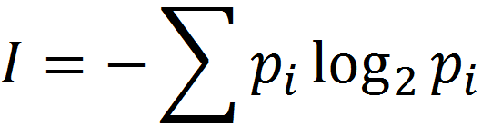
Shannon’s formula
If I – amount of information,
K – number of possible events,
pi – probabilities of individual events,
the amount of information for events with different probabilities can be determined by the formula:
where I is from 1to K.
Hartley’s formula can be seen as a particular case of Shannon’s formula.

Slide 11
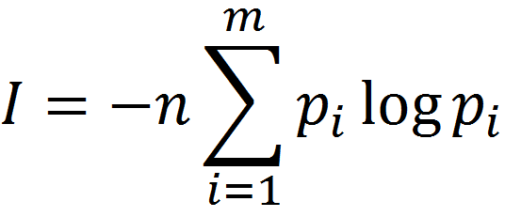
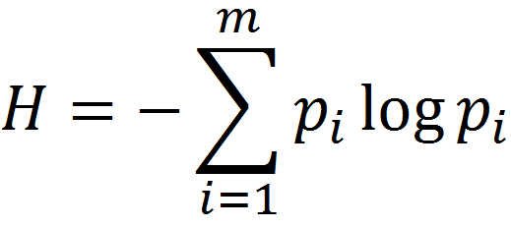
Shannon’s formula
Moving to the probabilities and logarithms with arbitrary bases we get Shannon's formula for the amount of information and entropy:

Slide 12
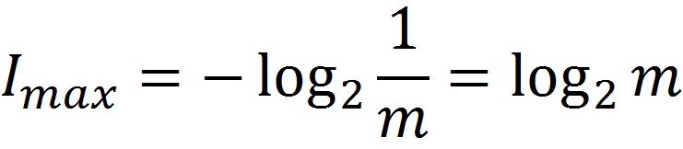
Information capacity of code
When the probability of occurrences of each character in the message is the same pi = 1/m, then
This expression is often called the information capacity of code.

Slide 13
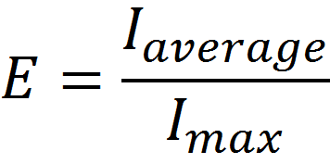

Efficiency and redundancy of the code
The concept of code efficiency is used for evaluating of code
Code redundancy

Slide 14

Efficiency and redundancy of the code
Most information that can be found in the message is
Average information can calculated by the Shannon’s formula.
So the amount of information in a message depends on applied code.

Slide 15
Example
It is known that the information capacity of the letters in the English language is about 1 bit. This phenomenon is due to the uneven frequency of occurrence of different letters. E T A letters occur frequently but Z Q X rarely . Pair of letters also occur with varying frequency. For example, TH - often, QZ - rare. Words also occur with varying frequency. An array of such statistical data related to the language is called the language structure.
Estimate the efficiency and redundancy of the English language

Slide 16
Example
If symbol appearance in words is equiprobable (26 characters + space = 27) then maximum information capacity of symbol will be
Imax = log2(27) = 4,76 бита.
It follows that
E = I average / Imax = 1/4.76 = 0,21
The redundancy of phrases in English is about 80 percent. Redundancy is supported by the fact that you can remove a lot of letters from the sentence and its meaning will be clear.

Slide 17
Try to read this message
MST PPL HV LTTL DFFCLTY N RDNG THS SNTNC

Slide 18
MST PPL HV LTTL DFFCLTY N RDNG THS SNTNC
MOST PEOPLE HAVE LITTLE DIFFICULTY IN READING THIS SENTENCE
19
Total - 51
40% approximatelly

Slide 19
Lab work 2
1. Find the entropy of guessing birth month of randomly man.
2. A message is written by characters of 128-character alphabet and contains 30 characters. What’s the maximum amount of information in this message?
3. A box contains 40 white and 10 black balls. Find probabilities of drawing white ball, black ball and the entropy of event.

Slide 20
Lab work 2
4. In a first group of 24 students only 6 of them got unsatisfactory mark, in the second – 9 from 27. In what case it’s more difficult to predict grades of students?
5. Let an asymmetrical tetrahedral pyramid is tossed. Probabilities of faces are following: p1=1/2, p2=1/4, p3=1/8, p4=1/8. Find the entropy of this event, then find the entropy for symmetrical tetrahedral pyramid and compare them.
6. Consider a source with source alphabet (a1, a2, a3, a4, a5, a6) in which the symbols probabilities are as follows: p1=0.27, p2=0.09, p3=0.23, p4=0.11, p5=0.15, p6=0.15. Compute the entropy of this source.

Slide 21
Lab work 2
7. A die is labeled from 1 to 6. Assuming it’s fair, what is the entropy of the roll? The die is relabeled with the even numbers from 2 to 12. What is its entropy now?
8. Consider a source with source alphabet (a1, a2, a3, a4) in which the symbols probabilities are as follows: р1 = 0,1 р2 = 0,1 р3 = 0,1 р4 = 0,7. Find the number of another alphabet’s symbols, which has equiprobable symbols and the same entropy.
9. Let the information capacity of one letter in Russian is about 1 bit. Compute redundancy of the Russian language (let the number of letters is 32).

